Slide 1
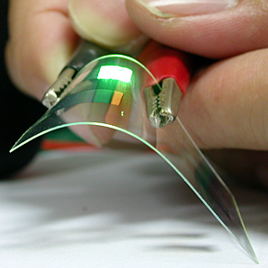
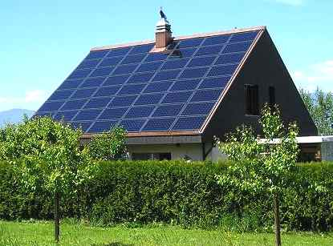
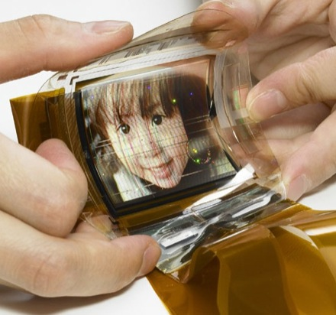
Electrical Science-2 (15B11EC211) Unit-4 Introduction to Semiconductor Lecture-1
Solar Cells
OLED
Technology
Dr. Archana Pandey

Slide 2
Outline of the module
Semiconductor Physics –
Energy Band Model
Carrier Statistics
Intrinsic Semiconductors
Extrinsic Semiconductors
Fermi Level
Charge densities in a semiconductor
Carrier Mobility and Drift Current
Hall Effect
Recombination of charges
Diffusion and conductivity equation

Slide 3
Today we will learn
What is a semiconductor?
What is the use of semiconductor?
Classification of semiconductors-
Elemental, Compound, Direct band gap and Indirect band gap semiconductors
Energy Band Model
Band formation in semiconductors
Energy Bands-
Conduction band, valence band, forbidden band
Energy Band Gap
Band gap of Silicon

Slide 4
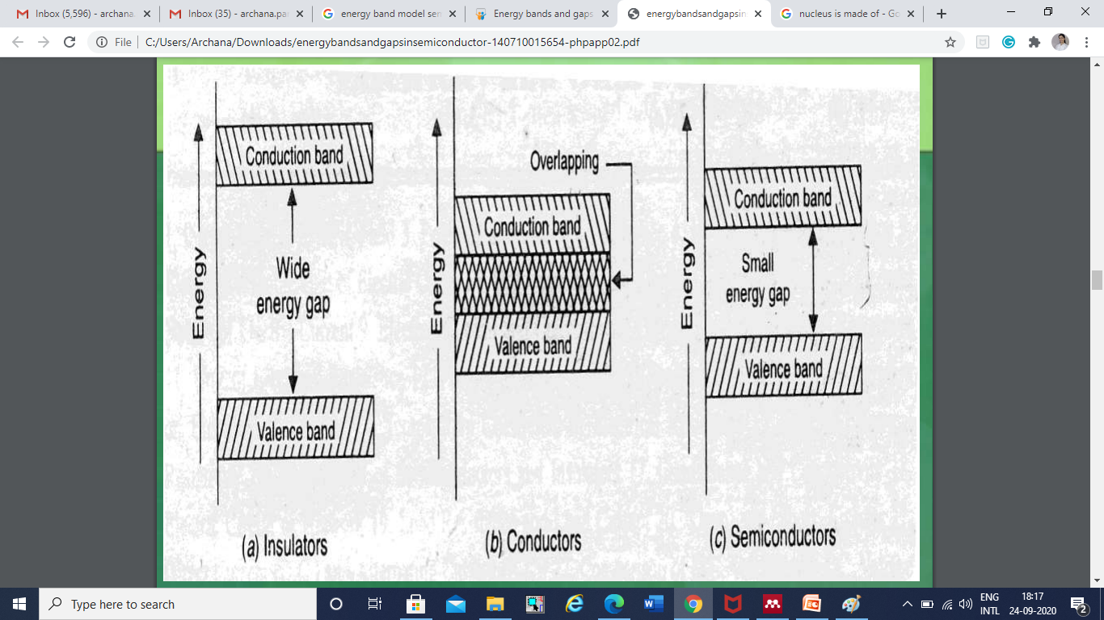
What is a semiconductor?
Types of Materials
Materials can be divided into 3 types based on the values of energy gap  Insulator  Conductor  Semiconductor
Semiconductor- A solid substance that has a conductivity between that of an insulator and that of most metals
Ref 1, 2

Slide 5
Energy Bands
Three important bands are
Valence band
Band of energy level which are closer to nucleus
An electron in valence band experiences strong force of attraction from nucleus and it can’t move freely when external electric field is applied
It is called bounded electron
Conduction Band
Bond of energy levels which are far away from the nucleolus.
The conduction band is the band of orbitals that are high in energy and are generally empty.
An e- in Conduction band has weak influence of nucleolus and hence it can move free under the effect of applied electric field and thus it produces current, it is called free electrons
Forbidden Band or energy band gap
In solid-state physics, an energy gap or bandgap, is an energy range in a solid where no electron states can exist.
It generally refers to the energy difference (in electron volts) between the top of the valence band and the bottom of the conduction band in insulators and semiconductors.
Ref 1

Slide 6
What is a semiconductor?…
Semiconductors are those substances whose conductivity lies in between that of a conductor and Insulator. Example: Silicon, germanium, Cealenium, Gallium, arsenide etc.
In terms of energy bands, semiconductors are those substances in which the forbidden gap (energy gap) is narrow.
Thus valence and conduction bands are moderately separated as shown in fig(C).
In semiconductors, the valence band is partially filled, the conduction band is also partially filled, and the energy gap between conduction band and valence band is narrow.
Therefore, comparatively smaller electric field is required to push the electrons from valence band to conduction band .
At low temperatures the valence band is completely filled and conduction band is completely empty.
Therefore, at very low temperature a semi-conductor actually behaves as an insulator.
Ref 1

Slide 7
Uses of semiconductor
Devices made of semiconductors, notably silicon, are essential components of most electronic circuits.
first practical application in 1904, development of the cat's-whisker detector, a primitive semiconductor diode used in early radio receivers.
Developments in quantum physics in turn led to the development of the transistor in 1947,[2] the integrated circuit in 1958, and the MOSFET (metal–oxide–semiconductor field-effect transistor) in 1959
The starting material used in the fabrication of VLSI devices is silicon in the crystalline form.
Ref 3, 4

Slide 8
Classification of semiconductors
There are different ways of classifying semiconductors depending on the property being measured.
One classification is
1. Elemental semiconductors - Si and Ge are the most common.
2. Compound semiconductors -II-VI and III-V are the most common (GaAs, GaAsP)
Another way of classifying semiconductors based on their band structure is
1. Direct band gap semiconductor
2. Indirect band gap semiconductor
Direct band gap semiconductors are useful for opto electronic devices like LEDs, and lasers.
The difference between direct and indirect band gap semiconductors is related to their band structure (we will discuss this after going through the energy band structure)
Ref 1

Slide 9
Energy Band Model
The formation of energy bands in semiconductors and insulators can be explained in an analogous manner to metals-
Metals have electrical conductivity. This is related to the fact that the energy band of the metal consists of continuous filled and empty states.
This is related to either a half full orbtial (alkali metals) or due to overlap between filled and empty orbitals (alkali earth metals).
At 0 K the highest filled state is called the Fermi energy (E_{F} ).
Because the energy difference between the states in the outer band is non-existent, at room temperature, electrons can easily move in the metal during application of an external field.
The electrons in the outer band of a metal are said to be delocalized, i.e. they belong to the entire solid rather than being tied down to a specific atom. These delocalized electrons are responsible for the high conductivity.
The difference being that in semiconductors (insulators) there is an energy gap between the filled valence band and the empty conduction band.
Ref 1

Slide 10
Band formation in semiconductors
Consider the example of energy band formation in Si (the most dominant in today microelectronics industry).
Si has an atomic number of 14
(electronic configuration is 1s²2s²2p⁶3s²3p²)
The 3s²3p² forms the outer shell and we can ignore the inner shells as far as electrical conductivity is considered.
The 3s and 3p orbitals in Si are close in energy and can hybridize to form sp3 orbitals.
Given that there are 4 electrons, a total of 4 sp3 hybrid orbitals are formed.
These form 4 bonds that are directed along the corners of a tetrahedron
Note- Hybridization is a common property of elements of Group IV of the periodic table to which Si belongs to. C which is in top of the group can form a variety of hybrid orbitals (sp3 , sp2 , sp). Both Si and the element below it, Ge, can form sp3 hybrid orbitals. In the case of Si, the hybrid orbitals interact the same way that atomic orbitals interact in metals.
Ref 1

Slide 11
Band formation in semiconductors…
Consider a bond formed between 2 sp3 hybrid orbitals (1 from each Si atom). The two orbitals can interact to form a bonding (σ) and anti-bonding (σ ∗ ) orbital.
Since each Si atom will contribute one electron to the bond there will be a total of 2 electrons which will both go to the bonding orbital.
Thus, each Si atom can form a bond with 4 other Si atoms and in all cases the bonding orbital (σ) will be full. A solid will be formed from a large number of these orbitals.
When the bonding orbitals interact they will form an energy band, called valence band.
This valence band will be completely full since the bonding orbital is full.
Similarly, the anti-bonding orbitals can interact to form an energy band, called conduction band.
This will be completely empty. Unlike metals, the valence and conduction band in a semiconductor is separated by a forbidden energy gap, this is called band gap.
Ref 1

Slide 12
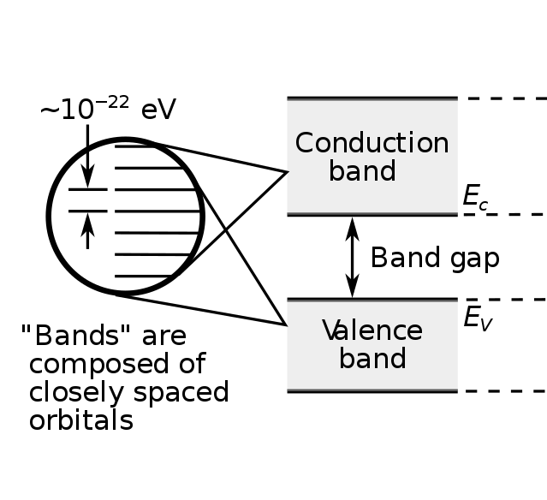
Band formation in semiconductors
Ref 1

Slide 13
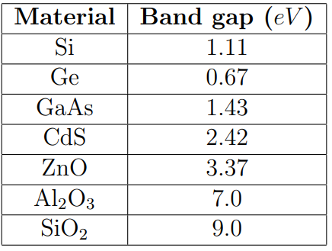
Energy Band Gap
In the case of Si, the band gap (Eg) has a value of 1.11 eV at room temperature (300 K).
The same argument for formation of a band gap (filled valence band and empty conduction band with a forbidden energy gap) can be extended to other semiconductors and insulators.
The difference between them is related to the magnitude of Eg.
Insulators have a band gap greater than 3 eV while semiconductors have band gap less than 3 eV .
This boundary is related to the energy boundary between the visible and UV regions of the spectrum (roughly 400 nm). Some typical values of band gap for different materials are listed in table 1.
Ref 1

Slide 14
Bandgap of Silicon
The valence band is completely filled with electrons and the conduction band is completely empty at absolute zero temperature
The separation between the conduction band and valence band, or the bandgap, is of the order of 1eV.
No electrical conduction is possible at 0 K,
Since there are no current carriers in the conduction band
What about valence band?
Question- Current carriers are available in the valence band, still no electrical conduction at 0 K, why?
Answer- Electrons in the completely filled valence band cannot be accelerated by an electric field and gain energy.
Ref 1

Slide 15
Bandgap of Silicon
Bandgap is small enough that at room temperature a small fraction of the electrons are excited into the conduction band, leaving behind vacancies, or holes, in the valence band.
This allows limited conduction to take place from the motion of both the electrons in the conduction band and the holes in the valence band completely filled with electrons
The energy of the electrons in the conduction band increases upward, while the energy of the holes in the valence band increases downward.
The bottom of the conduction band is designated E_{C}, and the top of the valence band E_{V}". Their separation, or the bandgap, is E_{g}= E_{C} - E_{V} ".
For silicon, Eg is 1.12 eV at room temperature or 300 K.
The bandgap decreases slightly as the temperature increases, with a temperature coefficient of dEg/dT -2.73 x 10-4 eV/K for silicon near 300 K.
Ref 1

Slide 16
References
Streetman, Ben G., and Sanjay Banerjee. Solid state electronic devices. Vol. 4. Englewood Cliffs, NJ: Prentice hall, 1995.
Sze and Ng," Physics of Semiconductor Devices", 3rd Ed., 2006
Shockley, William (1950). Electrons and holes in semiconductors : with applications to transistor electronics. R. E. Krieger Pub. Co. ISBN 978-0-88275-382-9.
Semiconductor Rectifiers Patented as "Cat's Whisker" Detectors". The Silicon Engine. Computer History Museum. 1901, Retrieved 23 August 2019.

